Slide 1

FORCASTING TIME SERIES

Slide 2
GROUP 1
NANDA KRISHNA
DHRUVA NITHIN
SHASHIDHAR
BHANU PRAKASH
ESHWAR
PHANI
MENTOR NAME:-
AISHWARYA AJAY MATE

Slide 3
OBJECTIVE
Develop a time series forecasting model to predict the closing prices of stocks for a given symbol on future dates. The model should utilize historical stock market data including attributes such as opening price, closing price, highest price, lowest price, trading volume, turnover, and other relevant factors. The forecasted prices will assist investors, traders, and financial analysts in making informed decisions regarding buying, selling, or holding stocks. The forecast horizon can be determined based on business requirements, but should aim to provide predictions for at least the next month.

Slide 4
Exploratory Data Analysis
We have the data set which consists of 5306 rows and 13 columns
We have performed some ed analysis
A)Describing the dataset
Our Dataset consists of 5306 rows and 13 columns
B)Cleaning the data
Considering this dataset we assumed that the symbol and series columns are not needed. So . we have dropped this columns.
C)Checking invalid records
We checked the dataset, and we found some invalid records
D)Missing value detection and imputation
We detected some missing values in the dataset and imputed with suitable code.
E)Duplicated records
We have not found any duplicate records in dataset
F)Outliers
We found some outliers using box plot method. And the outliers are present above the upper whisker line and we controlling the outliers with the caping method

Slide 5
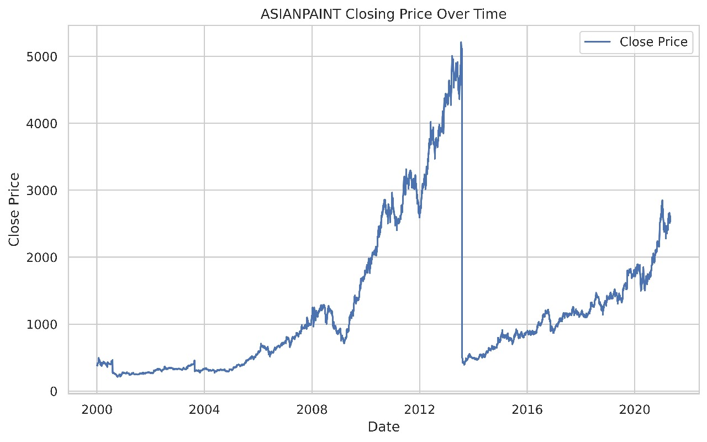
DATA VISUALIZATION Time series plot
This graph shows the distribution of closing price according to the date.
Since 2000 the stock price continuously raised till 2013.
There is a huge drop between 2013 to 2014.
After the huge drop the price again got raised as previously.

Slide 6
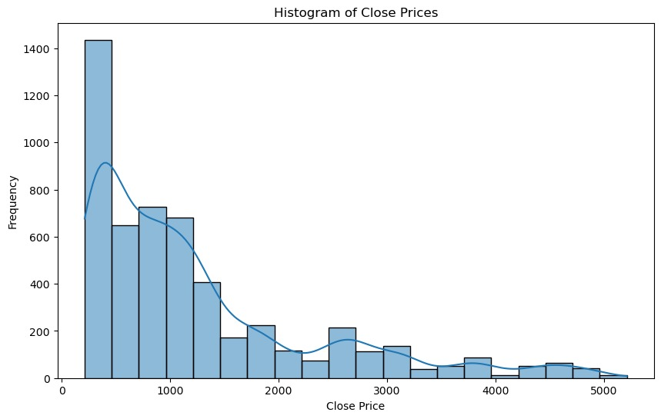
Histogram
This the positive skewed graph
This graph is skewed towards rights its known as positively skewed
right tail is longer so it indicates that there are some lower values in the data

Slide 7
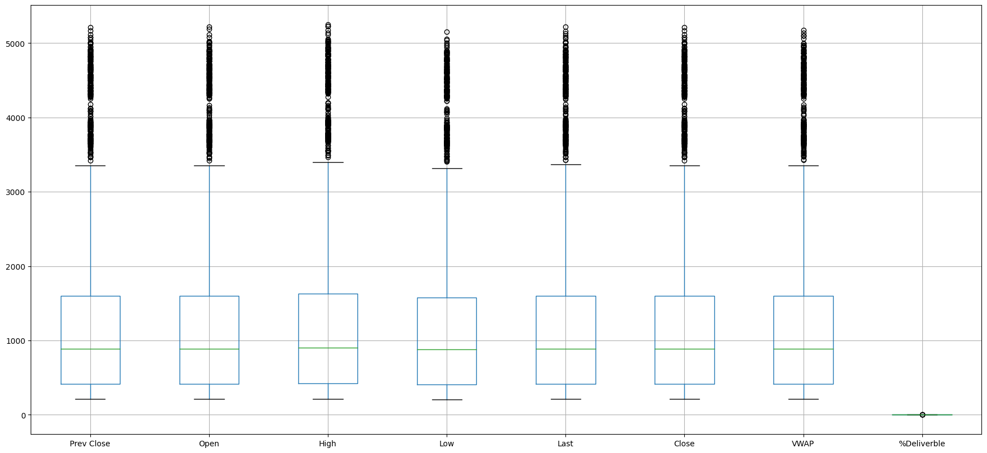
Box plot
This box plot for asianpaints
The median is closer to the bottom of the box so the data is right-skewed
there are many outliers which are present above the upper whisker line
So we are handling the outliers by caping method

Slide 8
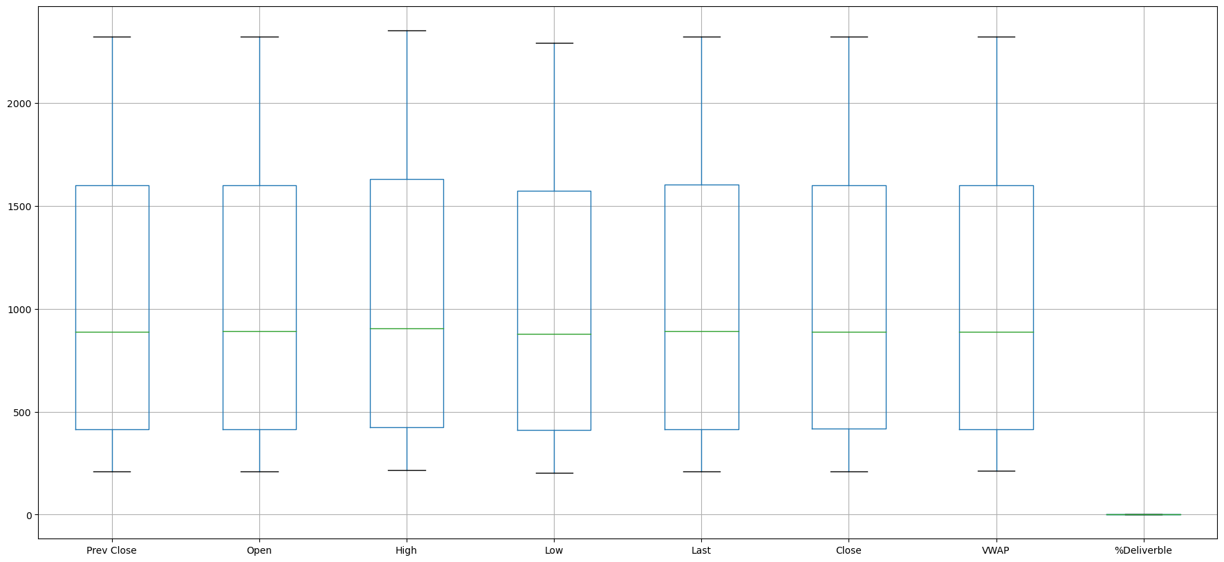
After handling the outliers
Here we can see there are no outliers
Because we resolved the outliers using capping method

Slide 9
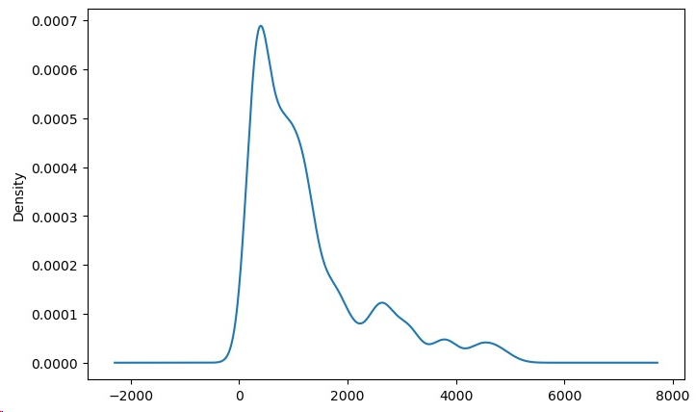
Density plot
Density plot visualizes the distribution of data our a continuous interval or time period
This chat is a variation of a histogram that uses carnal smoothing to plot values allowing for smoother distribution by smoothing out the noise
The peaks of a density plot to helps display where values are concentrated over the intervals

Slide 10
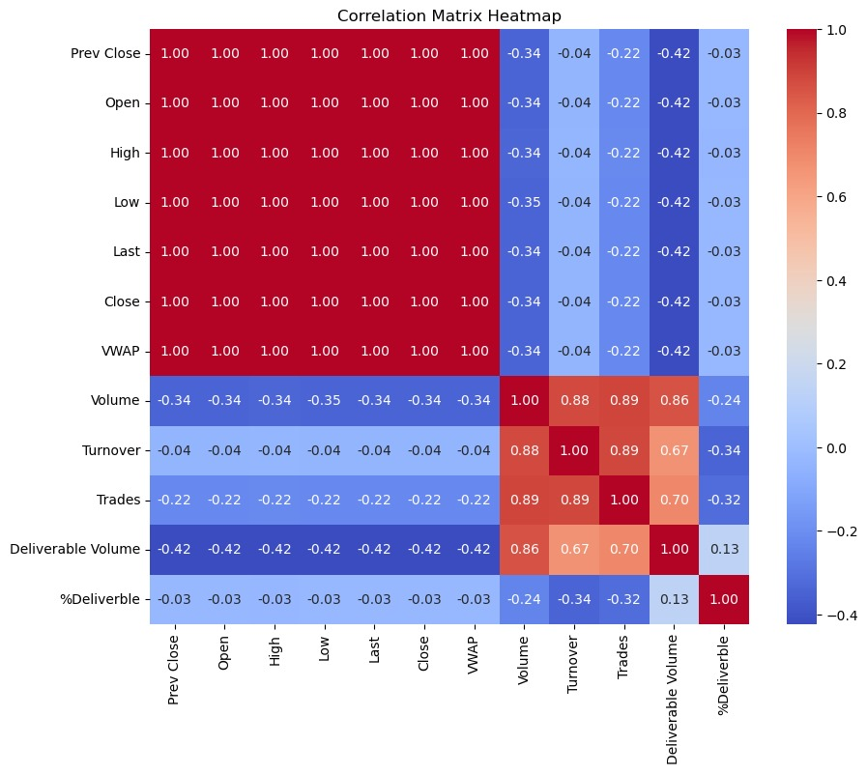
Correlation Matrix Heatmap

Slide 11
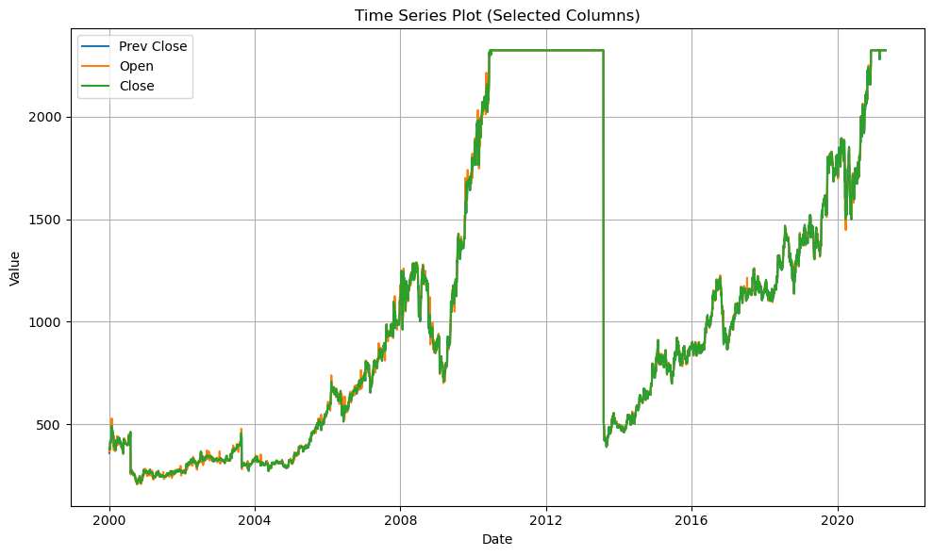
Time series plot (selected columns)

Slide 12
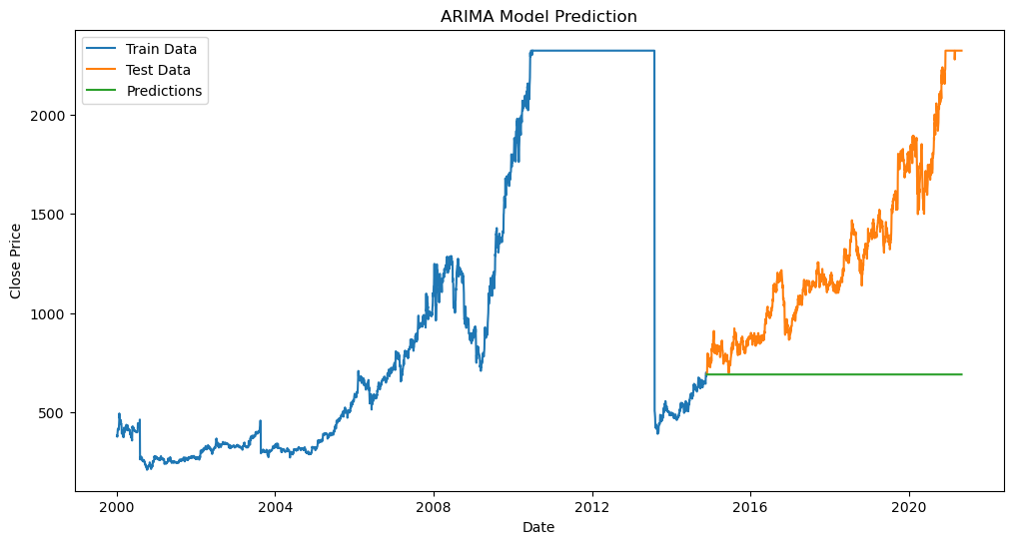
Model building ARIMA Model Prediction
Mean Squared Error 573443.0731497

Slide 13
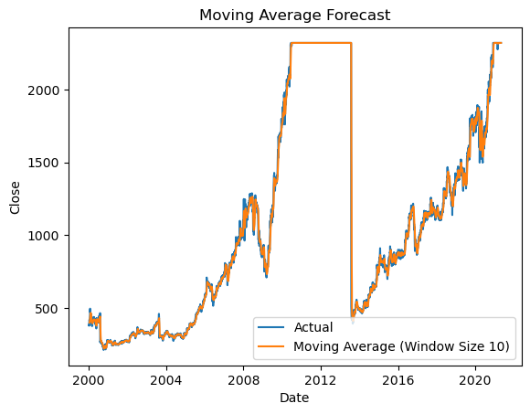
Moving Average Forecast
Mean Squared Error : 2534.41564

Slide 14
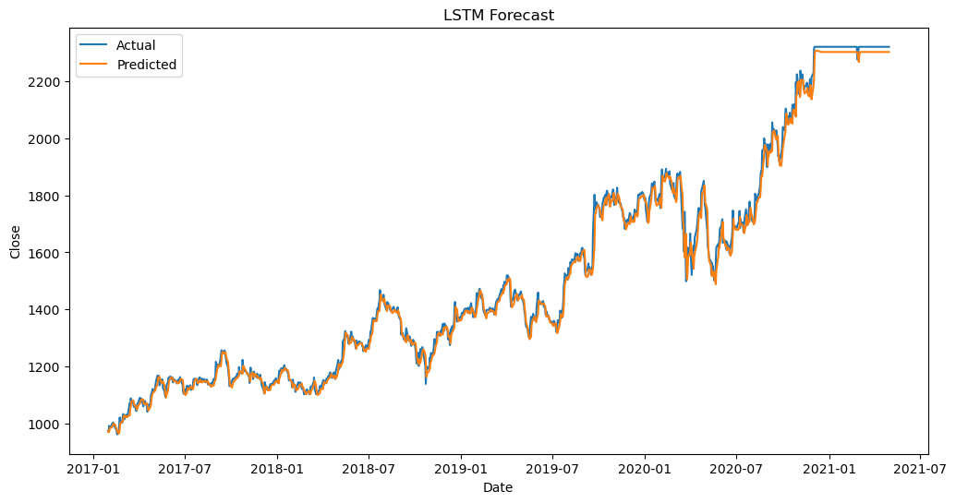
LSTM Forecasting model
Mean Squared Error : 728.88

Slide 15
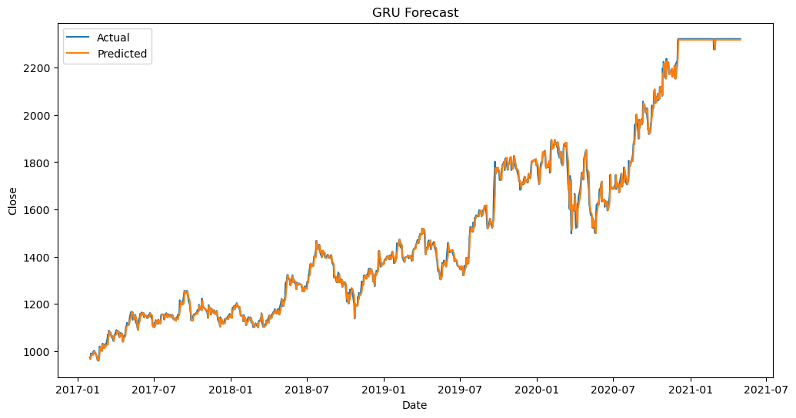
Gated Recurrent Unit(GRU) model
Mean Squared Error : 580.958810088

Slide 16
CONCLUSION
Observing the above Four models We Considered the Gated Recurrent Unit (GRU) Model for predicting the Price.
Because the MEAN SQUARED ERROR (MSE) of the GRU is lower compared to the other models

Slide 17
Challenges Faced
Communication: Effective communication is crucial for collaboration. Challenges may arise due to differences in communication styles, or language barriers. Establishing clear channels of communication
Coordination: Coordinating tasks and ensuring everyone is aligned with project goals can be challenging, especially when team members have different schedules or priorities. Using project management tools like Asana or Trello to assign tasks, track progress, and set deadlines can improve coordination and accountability.
Differing Skill Levels: Team members may have varying levels of expertise in data analysis techniques, programming languages, or domain knowledge. Providing opportunities for skill-sharing, training sessions, and mentorship can help bridge skill gaps and enhance the overall competency of the team.
Data Quality: The dataset may contain errors, inconsistencies, or missing values that can affect the accuracy of the analysis. For example, restaurant information may be incomplete or inaccurate, ratings may be inconsistent, or reviews may contain spam or irrelevant content.

Slide 18
DEPLOYMENT
We Have Deployed GRU model by using Streamlit

Slide 19
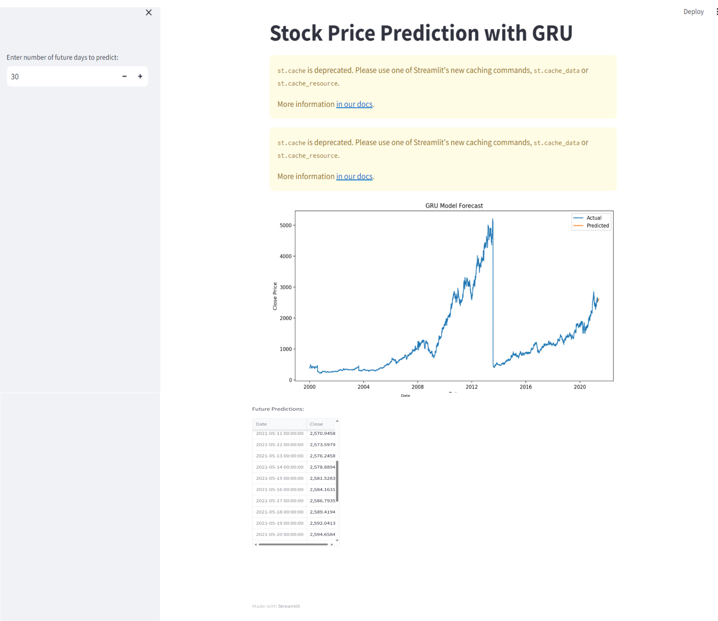

Slide 20
THANK YOU

